Slide 1
Religion 3
Spacial organization and religious conflict

Slide 2
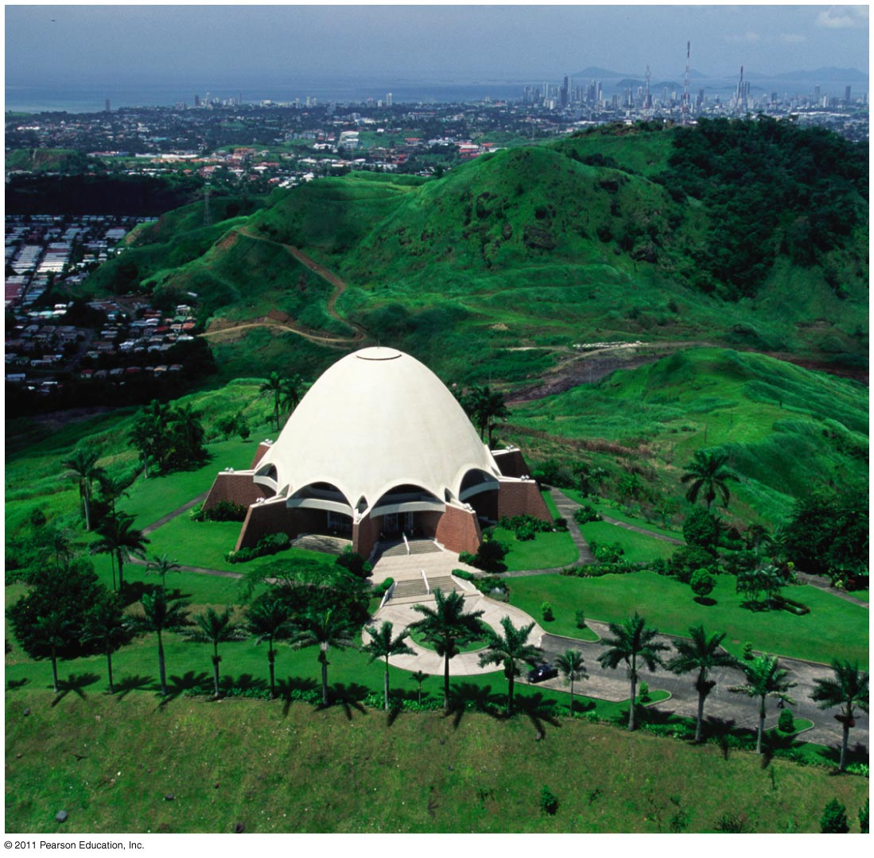
Why Do Religions Organize Space in Distinctive Ways?
Places of worship
Many types: Christian churches, Muslim mosques, Hindu temples, Buddhist and Shinto pagodas, Bahá’í houses of worship
Figure 6-19

Slide 3
Why Do Religions Organize Space in Distinctive Ways?
Sacred space
Disposing of the dead
Burial
Other ways of disposing of the dead
Religious settlements
Religious place names

Slide 4
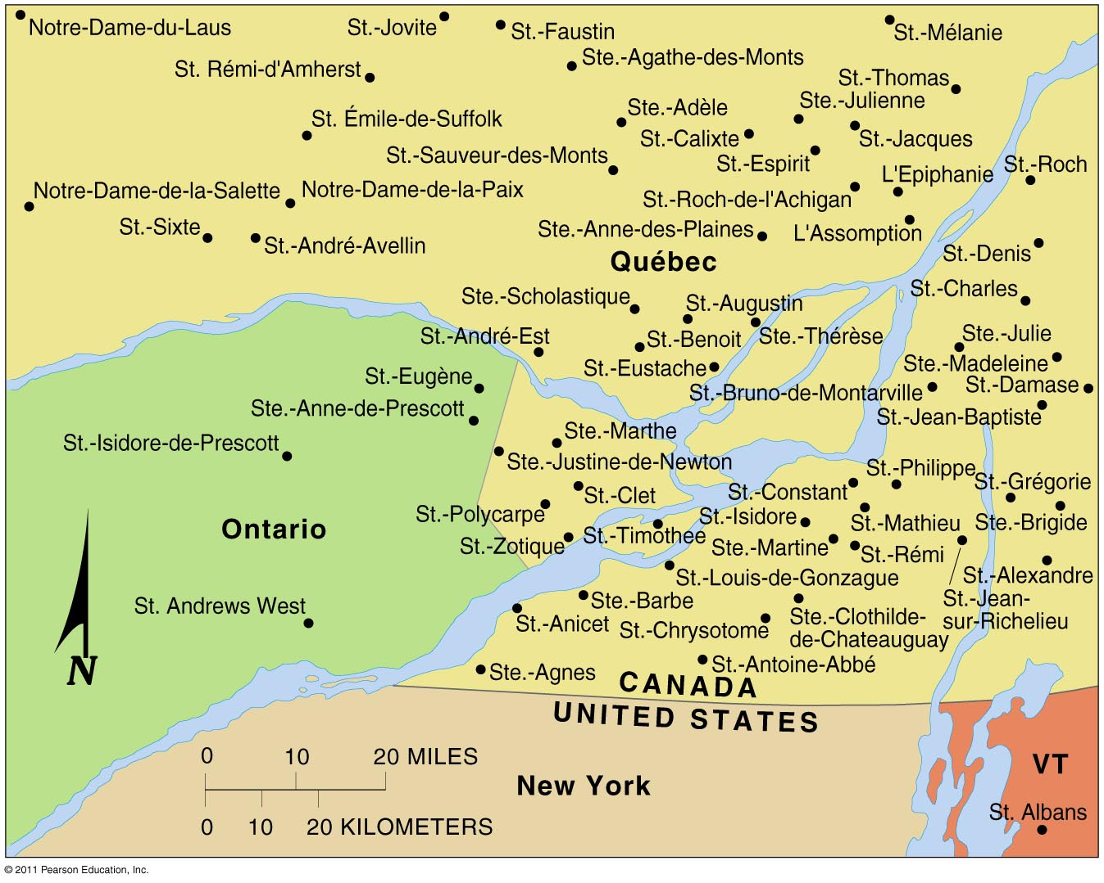
Religious Toponyms
Figure 6-21

Slide 5
Why Do Religions Organize Space in Distinctive Ways?
Administration of space
Hierarchical religions
Latter-day Saints
Roman Catholics
Locally autonomous religions
Islam
Protestant denominations

Slide 6
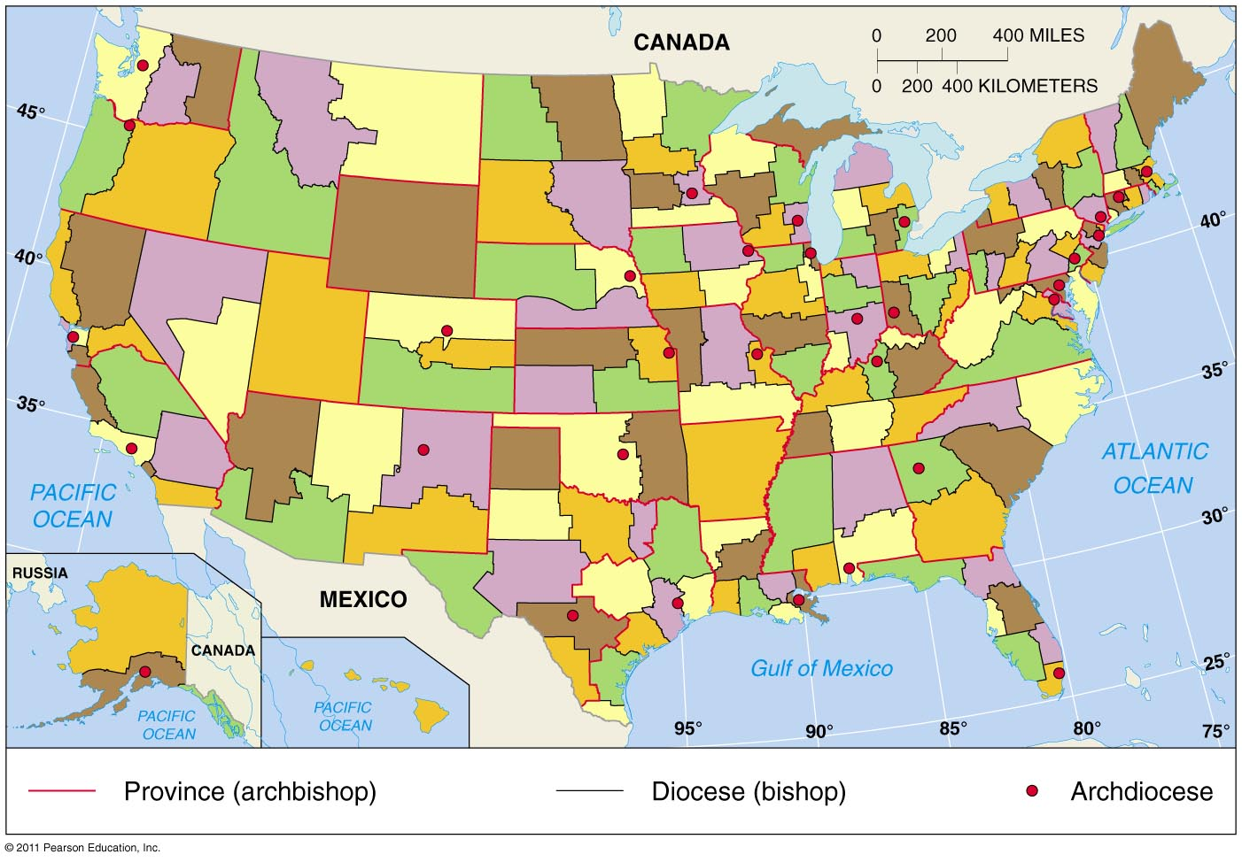
Roman Catholic Hierarchy in the United States
Figure 6-22

Slide 7
Why Do Territorial Conflicts Arise?
Religions versus government policies
Religion versus social change
Taliban and Western values
Hinduism and social inequality
Caste system
Religion versus communism
Eastern Orthodoxy and Islam in the Soviet Union
Buddhism in Southeast Asia

Slide 8
Why Do Territorial Conflicts Arise?
Religion versus religion
Fundamentalism
Religious wars in Ireland
Religious wars in the Middle East
Crusades (Christians in Muslim lands)
Jews and Muslims in Palestine

Slide 9
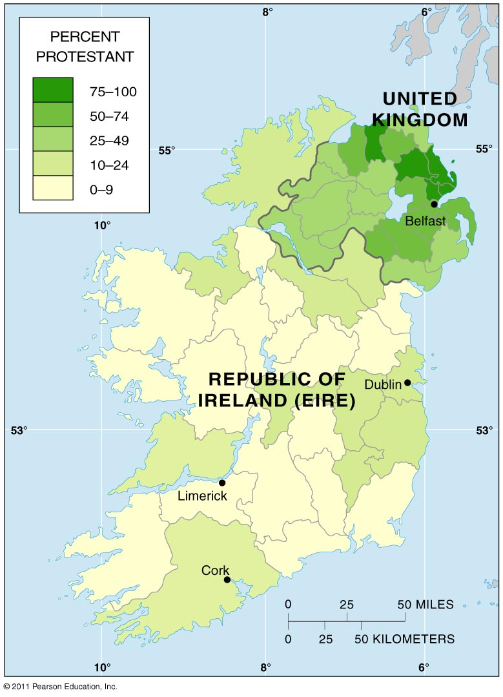
Distribution of Protestants in Ireland
Figure 6-23

Slide 10
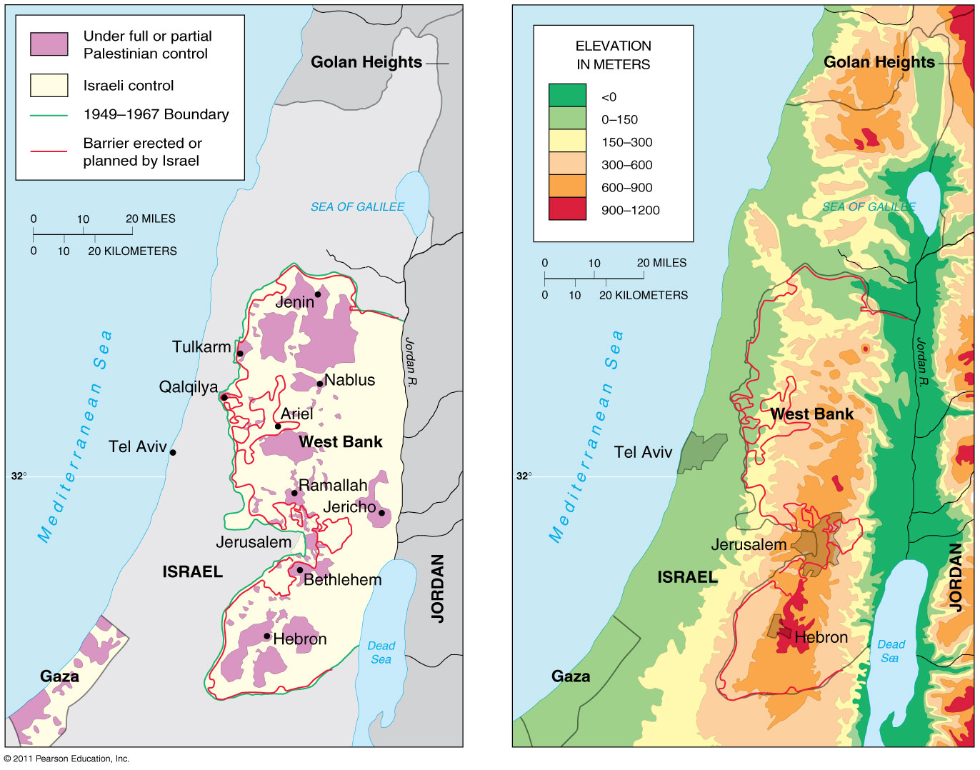
Two Perspectives on Palestine/Israel
Figure 6-26

Slide 11
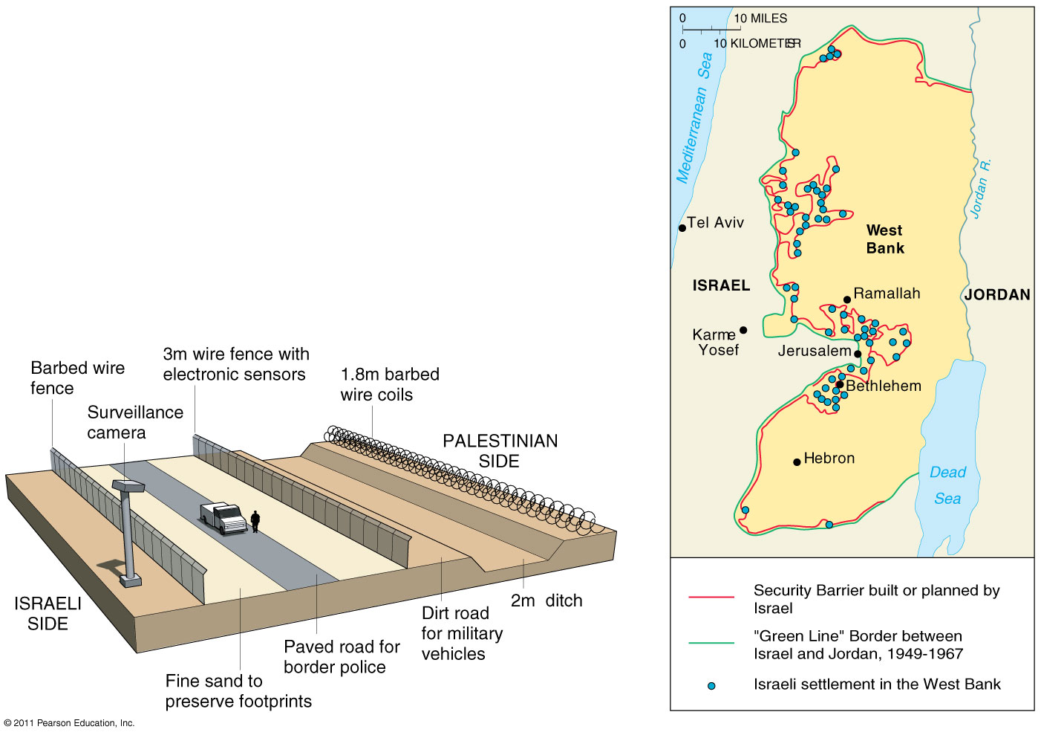
Israel’s “Separation Fence”
Figure 6-27

