Slide 1
Religion 2
ethnic religions

Slide 2
Where Are Religions Distributed?
Ethnic religions
Appeal to a smaller group of people living in one place
Origin of religions
Ethnic: unclear or unknown origins, not tied to a specific founder
Ethnic religions
Hinduism
The third-largest religion in the world (900 million adherents)
97 percent of Hindus are found in India
Many paths to spirituality

Slide 3
Where Are Religions Distributed?
Ethnic religions
Other ethnic religions
Confucianism (China)
Daoism (China)
Shinto (Japan)
Judaism (today: the United States, Israel)
The first monotheistic religion
Ethnic African religions
Animism

Slide 4
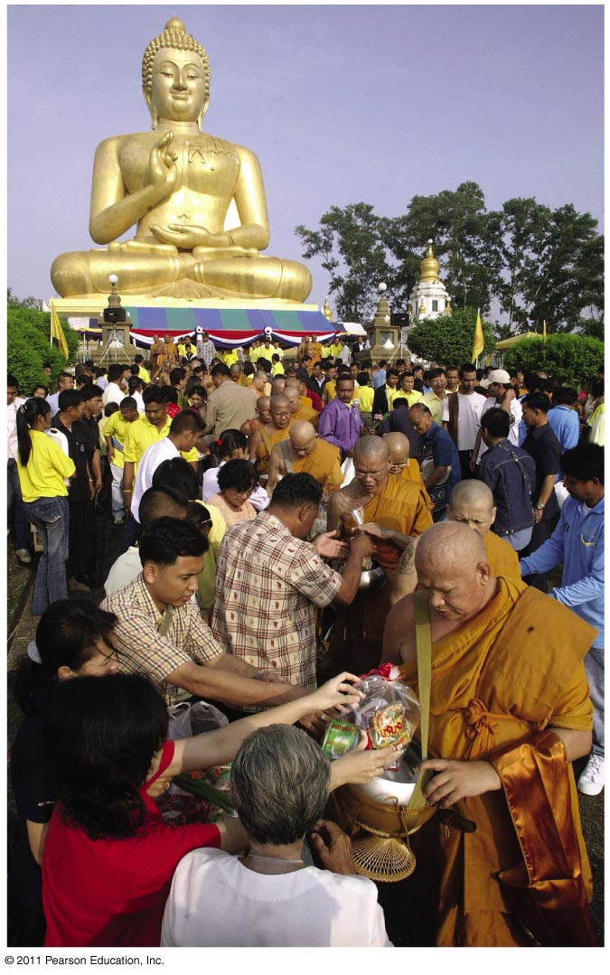
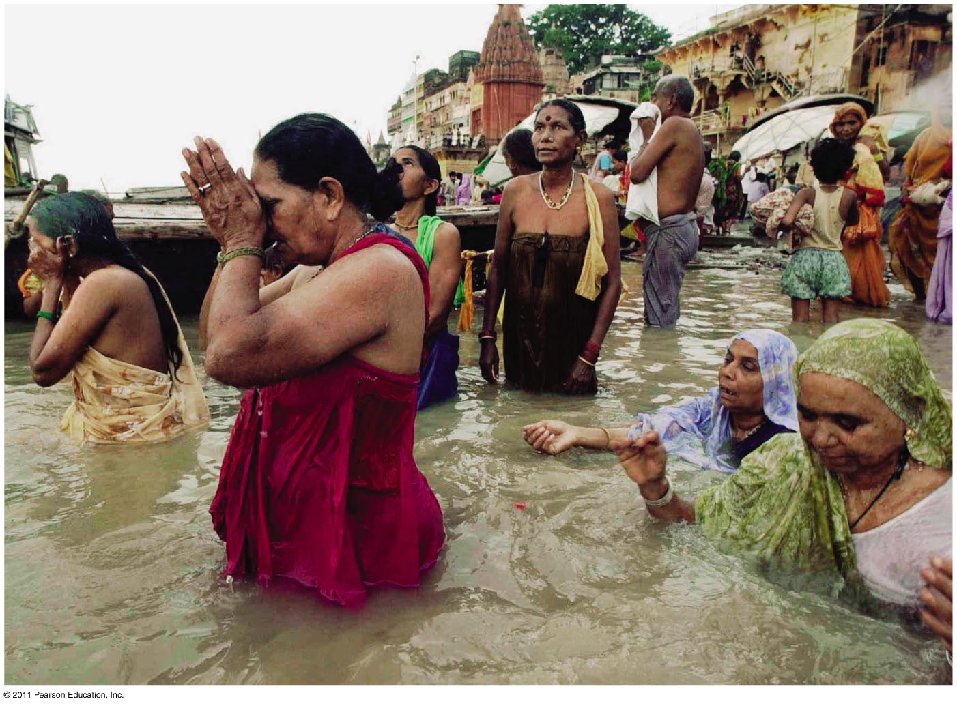
Ethnic Religions
Buddhism
Hinduism
Figure 6-5
Figure 6-4

Slide 5
Why Do Religions Have Different Distributions?
Limited diffusion of ethnic religions
Universal religions usually compete with ethnic religions
Examples of mingling:
Christianity with African ethnic religions
Buddhism with Confucianism in China and with Shinto in Japan
Ethnic religions can diffuse with migration
Judaism = exception
Holy places
In ethnic religions
Holy places in Hinduism = closely tied to the physical geography of India
Cosmogony in ethnic religions
The calendar
In ethnic religions = celebration of the seasons
The Jewish calendar
The solstice

Slide 6
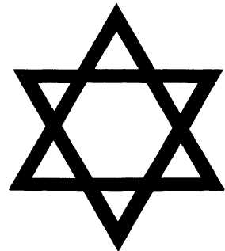
Judaism
Date/location of origin:
around 2000 BCE /Fertile Crescent region of the Middle East
Founder:
Abraham
Overview of beliefs:
Obey God's commandments
Live ethically
Focus is more on this life than the next
Important days:
Rosh Hashanah: Jewish New Year
Yom Kippur: Day of Atonement
Hanukkah
Passover

Slide 7
Place of worship/Spiritual leader:
Synagogue/Rabbi
Name for God:
Adonai
Holy book:
Torah
Practices:
Sabbath-Friday evening to Saturday evening Jews rest and pray.
Jews fast during Yom Kippur.
Jews follow kosher-rules about what Jews can and can’t eat.
Major Sects:
Orthodox-strict following of Jewish laws and practices
Conservative-follows most Jewish laws and practices
Reformed-follows only most important Jewish laws and practices

Slide 8
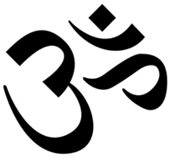
Hinduism
Date/location of origin
Earliest forms date to 1500 BC or earlier
Founder
None, collection of beliefs that developed over time
Overview of beliefs
Humans are in bondage to ignorance and illusion, but are able to escape.
Purpose is to gain release from rebirth, or at least a better rebirth.
Important days:
Mahashivarati (mid-February) - Great Festival of Shiva
Holi (Spring) - It celebrates spring & various events in Hindu mythology
Notes:
Collection of religious beliefs that developed over time, no founder nor a date of origin;
Pantheistic - a doctrine that equates God with the forces and laws of the universe
4 purposes of life:
dharma - fulfill moral, social and religious duties
artha - attain financial and worldy success
kama - satisfy desires and drives in moderation
moksha - attain freedom from reincarnation

Slide 9
Place of worship/spiritual leader:
Temple or home shrine
Guru or sage
Name for God(s):
One Supreme Reality (Brahman) manifested in many gods and goddesses
Sacred Text:
Vedas, Upanishads, Sutras, Bhagavad Gita
Some practices:
Yoga, meditation, worship, devotion to a god or goddess, pilgrimage to holy cities, live according to one's dharma (purpose/ role).
Ideas of Karma and reincarnation strengthened caste system.
Notes:
Hinduism has commonly been viewed in the west as a polytheistic religion - one which worships multiple deities: gods and goddesses. Although a widespread belief, this is not particularly accurate.
Some have viewed it as a monotheistic religion, because it recognizes only one supreme God: the panentheistic principle of Brahman, that all reality is a unity. The entire universe is seen as one divine entity who is simultaneously at one with the universe and who transcends it as well.
Some view Hinduism as Trinitarian because Brahman is simultaneously visualized as a triad -- one God with three persons:
Brahma the Creator who is continuing to create new realities
Vishnu, (Krishna) the Preserver, who preserves these new creations. Whenever dharma (eternal order, righteousness, religion, law and duty) is threatened, Vishnu travels from heaven to earth in one of ten incarnations.
Shiva, the Destroyer, is at times compassionate, erotic and destructive.
Strictly speaking, most forms of Hinduism are henotheistic; they recognize a single deity, and recognizes other gods and goddesses as facets, forms, manifestations, or aspects of that supreme God.
Shiva (or Siva) is one of the chief deities of Hinduism. In the most famous myth concerning Shiva, he saves humanity by holding in his throat the poison that churned up in the waters and threatened mankind. For this reason he is often depicted with a blue neck.
Holi - is time of disregarding social norms and indulging in general merrymaking.
Holi is probably the least religious of Hindu holidays. During Holi, Hindus attend a public bonfire, spray friends and family with colored powders and water, and generally go a bit wild in the streets.
The religious life of many Hindus is focused on devotion to God (perceived as Brahman, Shiva, Vishnu, or Shakti) or several gods. This devotion usually takes the form of rituals associated with sculptures and images of gods in home shrines.
One god Brahman (the creator) with many forms; Vishnu, the protector; Shiva, the destroyer; later, many forms of a great Mother Goddess
most forms of Hinduism are henotheistic; they recognize a single deity, and recognizes other gods and goddesses as facets, forms, manifestations, or aspects of that supreme God.

Slide 10
Taoism
Date/location of origin
550 bce
Founder
Lao-Tze (based on the teachings of the Tao Te Ching)
Place of worship/Spiritual Leader:
Temple/Sage
Sacred texts:
Tao Te Ching, Chuang Tzu
Some practices:
General attitude of detachment and non-struggle, "go with the flow" of the Tao.
Tai-chi, acupuncture, and alchemy to help longevity.
Daoism and Confucianism form complementary systems of thought.
Daoism deals with the natural world, while Confucianism deals more with the social world.

Slide 11
Overview of beliefs
Purpose is inner peace, harmony, and longevity
Achieved by living in accordance with the Tao
Tao = Flow of the universe. It keeps the universe in balance and in order.
Followers sought complete harmony with the patterns of nature.
No gods, only one with the flow of the universe.
Yin and yang
Universe:
Pantheism – the Tao encompasses all
Notes:
Tao – natural order of the universe
Yin – darkness, femininity, passivity, and water
Yang – light, masculinity, activity, and air
Goal is to keep these opposites in balance within his/her life.
Tao is the first-cause of the universe. It is a force that flows through all life. "The Tao surrounds everyone and therefore everyone must listen to find enlightenment." 1 A believer's goal is to harmonize themselves with the Tao. Taoism has provided an alternative to the Confucian tradition in China. The two traditions have coexisted in the country, region, and often within the same individual. The priesthood views the many gods as manifestations of the one Dao, "which could not be represented as an image or a particular thing." The concept of a personified deity is foreign to them, as is the concept of the creation of the universe. Thus, they do not pray as Christians do; there is no God to hear the prayers or to act upon them. They seek answers to life's problems through inner meditation and outer observation.
Pantheism is the view that the Universe (Nature) and God are identical.[1] Pantheists thus do not believe in a personal, anthropomorphic (the attribution of human characteristics to animals or non-living things) or creator god.
Pantheism denotes the idea that “God” is best seen as a way of relating to the Universe.

Slide 12
Confucianism
Date/location of origin
6th-5th cent. BC/ China
Founder
Confucius
Overview of beliefs
Purpose of life is to fulfill one's role in society with propriety, honor, and loyalty.
Focus on morality and good deeds.
Believe in Filial Piety - showing respect for family both living and dead.
Notes:
" 'Filial piety' ... is considered among the greatest of virtues and must be shown towards both the living and the dead (including even remote ancestors). The term 'filial' (meaning 'of a child') characterizes the respect that a child, originally a son, should show to his parents. This relationship was extended by analogy to a series of five relationships:" The Five Bonds: Ruler to Subject Father to Son Husband to Wife Elder Brother to Younger Brother Friend to Friend.

Slide 13
Sacred Texts:
The Si Shu or Four Books: including the Analects by Confucius.
The Wu Jing or Five Classics
Some practices:
Honesty, politeness, propriety, humaneness, perform correct role in society, loyalty to family, nation

Slide 14
Shintoism
Date/location of origin
4th century Japan
Founder
No specific founder
Overview of beliefs
individual shrines
Sacred texts
kojiki
Holy days
gion and takayama festivals

Slide 15
Names for gods
kami
Places of worship
temples
shrines
Practices
worship at shrines locally and around the world

Slide 16
animism
Date/location of origin
Unknown rural areas of Africa, south east asia, and amazon basin
Founder
none specific
Holy text
none, all stories shared orally
Place of worship
nature

Slide 17
Overview of beliefs
Belief that objects, such as plants and stones, or natural events, like thunderstorms and earthquakes, have a discrete spirit and conscious life.
Holy Days
varies by location
Major practices
varies by location
Major sects
American Indian
voodoo

