Slide 1
Religion 1
Universalizing religions

Slide 2
Why Do Religions Have Different Distributions?
Universalizing religions
Seek to appeal to all people
Origin of religions
Universalizing: precise origins, tied to a specific founder
Christianity
Founder: Jesus
Islam
Prophet of Islam: Muhammad
Buddhism
Founder: Siddhartha Gautama
Baha’I
the bab
Sikhism
Guru nanak

Slide 3
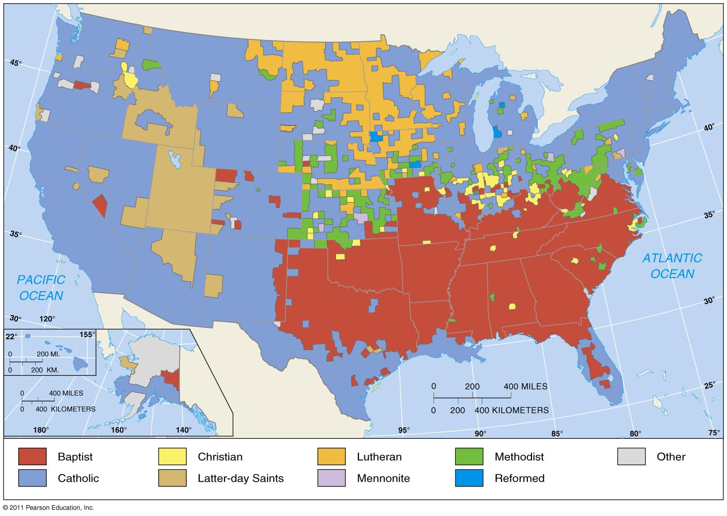
Distribution of Christians in the United States
Figure 6-2

Slide 4
Why Do Religions Have Different Distributions?
Diffusion of religions
Universalizing religions
Christianity
Diffuses via relocation and expansion diffusion
Islam
Diffuses to North Africa, South and Southeast Asia
Buddhism
Slow diffusion from the core

Slide 5
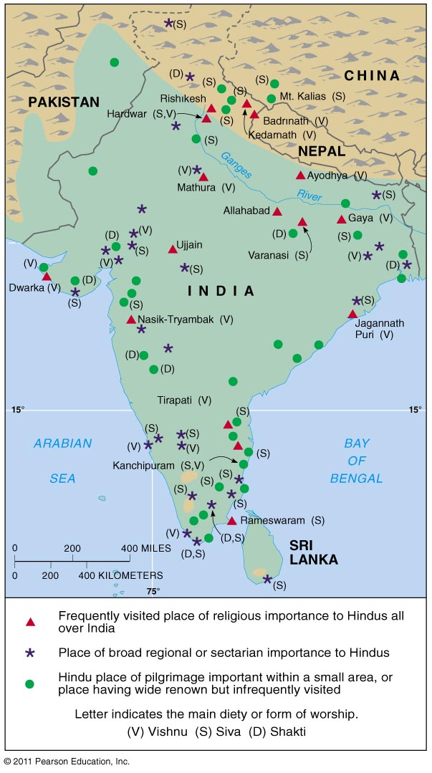
Diffusion of Universalizing Religions
Figure 6-17

Slide 6
Christianity
DATE/LOCATION OF ORIGIN
EARLY 1ST CENTURY AD/JERUSALEM, ISRAEL
FOUNDER
BEGAN AS A FORM OF JUDAISM WITH THE TEACHINGS, MIRACLES, CRUCIFIXION AND RESURRECTION OF JESUS
OVERVIEW OF BELIEFS
ALL HAVE SINNED AND ARE SEPARATED FROM GOD. SALVATION IS THROUGH FAITH IN CHRIST AND FOR SOME SACRAMENTS AND GOOD WORKS.
SOME IMPORTANT DAYS:
CHRISTMAS
PALM SUNDAY
GOOD FRIDAY
EASTER ASH WEDNESDAY
LENT

Slide 7
place of worship/Spiritual Leader:
Church, chapel, cathedral, basilica, meeting hall
Priest, bishop, archbishop, pope, pastor, minister, preacher
Name for God:
God is one but three distinct “persons” constitute one God: The Father, the son and the Holy Spirit – The Trinity
God, Lord, Christ, Messiah, Savior….
Holy book:
The Bible – Old and New Testament
Practices (in general, can vary depending on denomination)
Baptism
Communion
Sunday Services
Prayer
Bible Study
Major Sects
Roman Catholic
Eastern Orthodox
Protestant: Lutheran, Baptist, Methodist, etc.

Slide 8
Islam
Date/location of origin
Around 622 AD/ Mecca, Saudi Arabia
Founder
Prophet Muhammad
Overview of beliefs
Submit to the will of Allah and attain paradise after death
Important days:
Ramadan (month long)
Eid al-Fitr - Festival of the Breaking of the Fast
Al-Hijra - the Islamic New Year
Eid al-Adha (Arabic عيد الأضحى, "Festival of the Sacrifice)

Slide 9
Place of worship/Spiritual Leader:
Mosque (Friday service)
Sheikh; Imam (Shi'ite)
Name for God:
Allah
Holy book:
Qur’an
Some practices:
Five Pillars
1. Confession of faith
2. Daily prayer (5x)
3. Alms tax (charity)
4. Pilgrimage to Mecca
5. Fasting during Ramadan
Major sects:
Sunni - followed Abu Bakr
Shiite – followed Ali

Slide 10
Buddhism
Date/location of origin
520 BC/ Northeastern India
Founder
Siddhartha Gautama
Overview of beliefs
Four Noble Truths:
1. All of life is marked by suffering.
2. Suffering is caused by desire and attachment.
3. Suffering can be eliminated.
4. Suffering is eliminated by following the Eightfold Path
Noble Eightfold Path:
1. Right beliefs
2. Right aspirations
3. Right speech
4. Right conduct
5. Right livelihood
6. Right effort
7. Right mindfulness
8. Right meditational attainment
reincarnation, ultimate goal of nirvana-release from selfishness and pain
Notes:
Purpose is to avoid suffering and gain enlightenment and release from cycle of rebirth, or at least attain a better rebirth by gaining merit.

Slide 11
Important days:
Vary by region, but often include Buddha's birthday
Place of worship:
Temple, meditation hall/ monk
Holy book:
Pali Canon (Tripitaka), Mahayana sutras like the Lotus Sutra
Some practices:
Meditation, mantras, devotion to deities (in some sects), mandalas (Tibetan)
Major sects:
Theravada -closely follow the original beliefs and practices of the Buddha and the early monastic Elders
Mahayana - more liberal, accessible interpretation available to people from all walks of life
Vajrayana – Tibetan Buddhism (Dalai Lama)
Notes:
Rebirth or nirvana. Nirvana is seen simply as the cessation of suffering by some and as a heavenly paradise by others.
Rebirth or nirvana. Nirvana is seen simply as the end of suffering by some and as a heavenly paradise by others.

Slide 12
Baha'i faith
Date/Location of origin
Mid 1800s Iran/Iraq
Founder
bab
baha’u’llah
Overview of beliefs
Baha’u’llah is the promised one
Unity of mankind
Important days
9 holy days that commemorate the life of the bab and baha’u’llah
Baha’I new year

Slide 13
Places of worship
homes of the baha’I
meeting houses
Holy book
tablets
kitab-i-Aqdas
kitab-i-iqan
Practices
19 day months
19 days of fasting
9 days of pilgrimage
service
Major sects
none

Slide 14
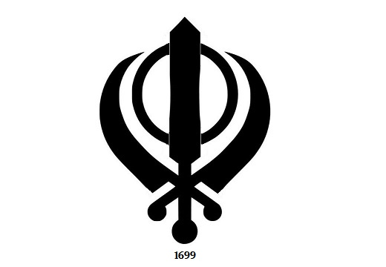
Sikhism
Date/Location of origin
Punjab region of India subcontinent
1500s
Founder
Guru Nanak
Overview of beliefs
Oneness of god
diversity is a divine gift from god
a combination of Hindu and Muslim beliefs
Important days
birthday of guru nanak
birthday of guru gobind singh
anniversary of the martyrdom of guru arjan
anniversary of the martyrdom of guru tegh bahadur

Slide 15
Place of worship
temple
gurdwara
Holy book
adi granth
dasam granth
Major practices
Sunday services
duty to society
mul mantra
Major sects
none

