Slide 1
Language 2

Slide 2
Where Are Other Language Families Distributed?
Classification of languages
Indo-European = the largest language family
46 percent of the world’s population speaks an Indo-European language
Sino-Tibetan = the second-largest language family
21 percent of the world’s population speaks a Sino-Tibetan language
Mandarin = the most used language in the world

Slide 3
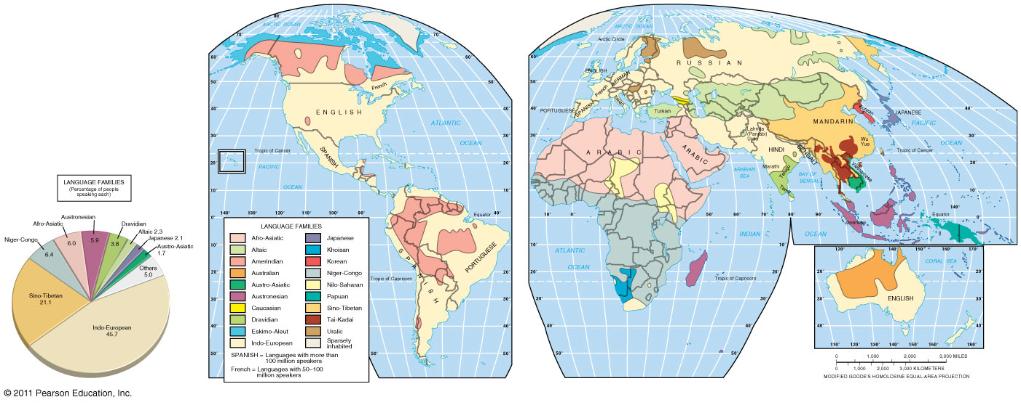
Language Families
Figure 5-16

Slide 4
Where Are Other Language Families Distributed?
Languages of the Middle East and Central Asia
Afro-Asiatic
Arabic = most widely spoken
Altaic
Turkish = most widely spoken
Uralic
Estonian, Hungarian, and Finnish

Slide 5
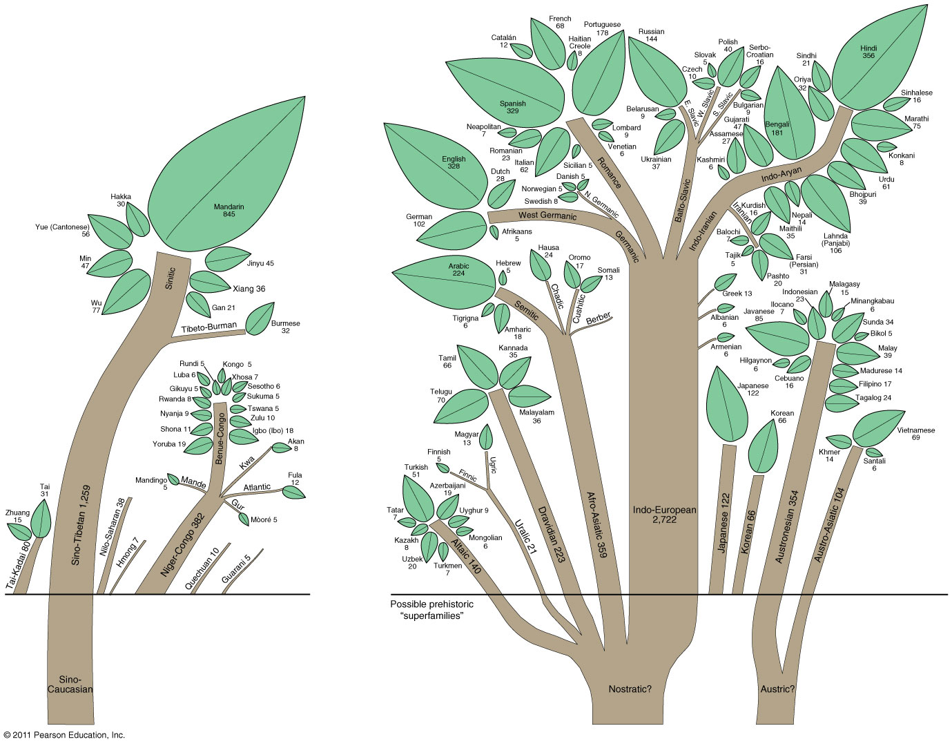
Language Family Tree
Figure 5-17

Slide 6
Where Are Other Language Families Distributed?
African language families
Extensive linguistic diversity
1,000 distinct languages + thousands of dialects
Niger-Congo
95 percent of sub-Saharan Africans speak a Niger-Congo language
Nilo-Saharan
Khoisan
“Click” languages

Slide 7
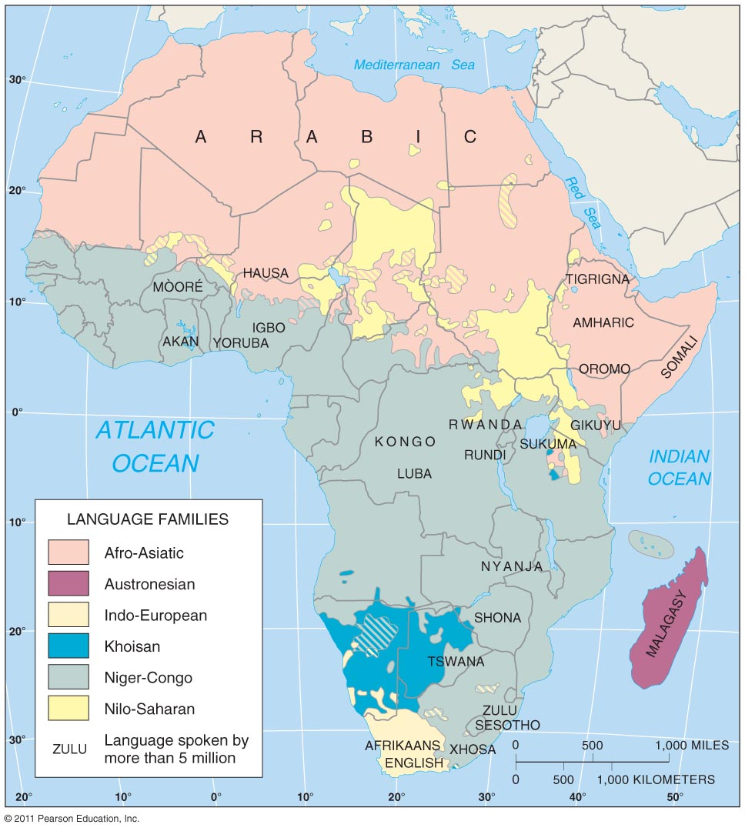
African Language Families
Figure 5-19

Slide 8
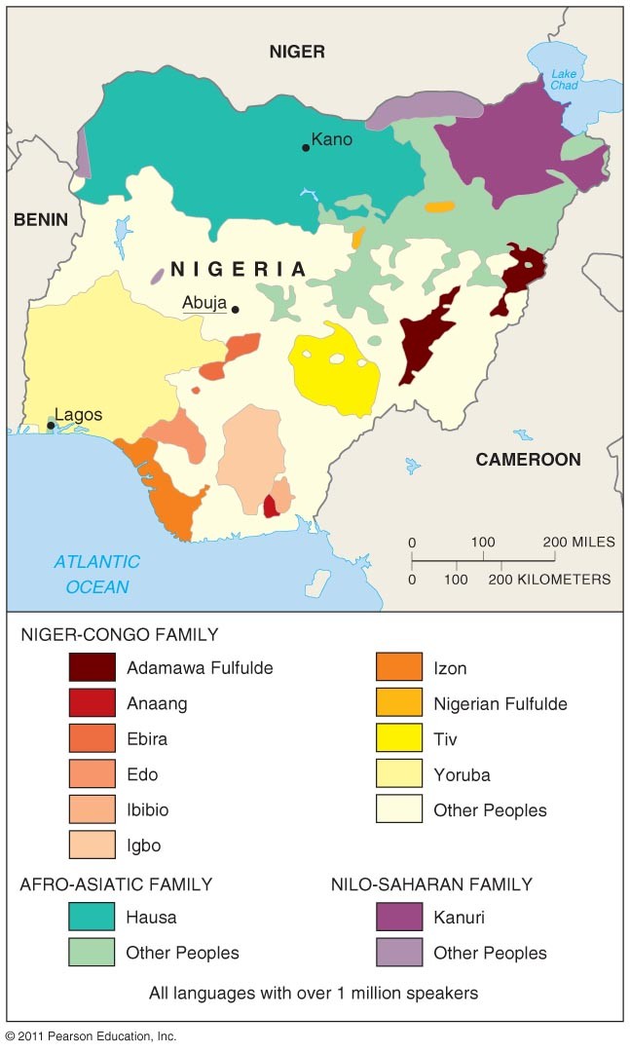
Nigeria’s Main Languages
Figure 5-20

Slide 9
Why Do People Preserve Languages?
Preserving language diversity
Extinct languages
473 “endangered” languages today
Examples
Reviving extinct languages: Hebrew
Preserving endangered languages: Celtic
Multilingual states
Walloons and Flemings in Belgium
Isolated languages
Basque
Icelandic

Slide 10
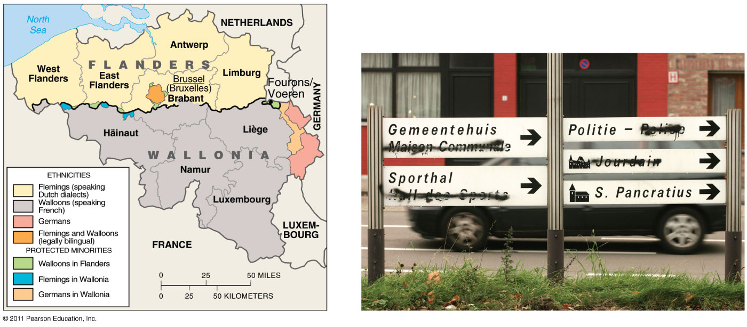
Languages in Belgium
Figure 5-23

Slide 11
Why Do People Preserve Languages?
Global dominance of English
English: An example of a lingua franca
Lingua franca = an international language
Pidgin language = a simplified version of a language
Expansion diffusion of English
Ebonics

Slide 12
Why Do People Preserve Languages?
Global dominance of English
Diffusion to other languages
Franglais
The French Academy (1635) = the supreme arbiter of the French language
Spanglish
Denglish

