Slide 1
Language 1

Slide 2
Language
Shows globalization and local diversity
How a language develops:
Interaction and Isolation
People in two locations speak the same language due to migration
If they have few connections after migration, language begins to differ
After a long period w/o contact groups will speak languages so different they are classified as 2 separate languages

Slide 3
Where Are English Language Speakers Distributed?
Origin and diffusion of English
English is spoken by 328 million as a first language
Spoken fluently by ½ to 1 billion
Is the official language in 57 countries
2 billion (1/3 of pop.) lives in a country where it is the official language, but cannot speak it
English colonies
Origins of English
German invasions
Norman invasions

Slide 4
German Invasion
Jutes – N. Denmark
Angles – S. Denmark
Saxons – NW Germany
Anglo-Saxons- trace cultural heritage to England
English evolved from the 3 tribes language
England Angles Land Engles (old English)
Angles language Englisc
3 Germanic Tribes – Invaded the British Isles

Slide 5
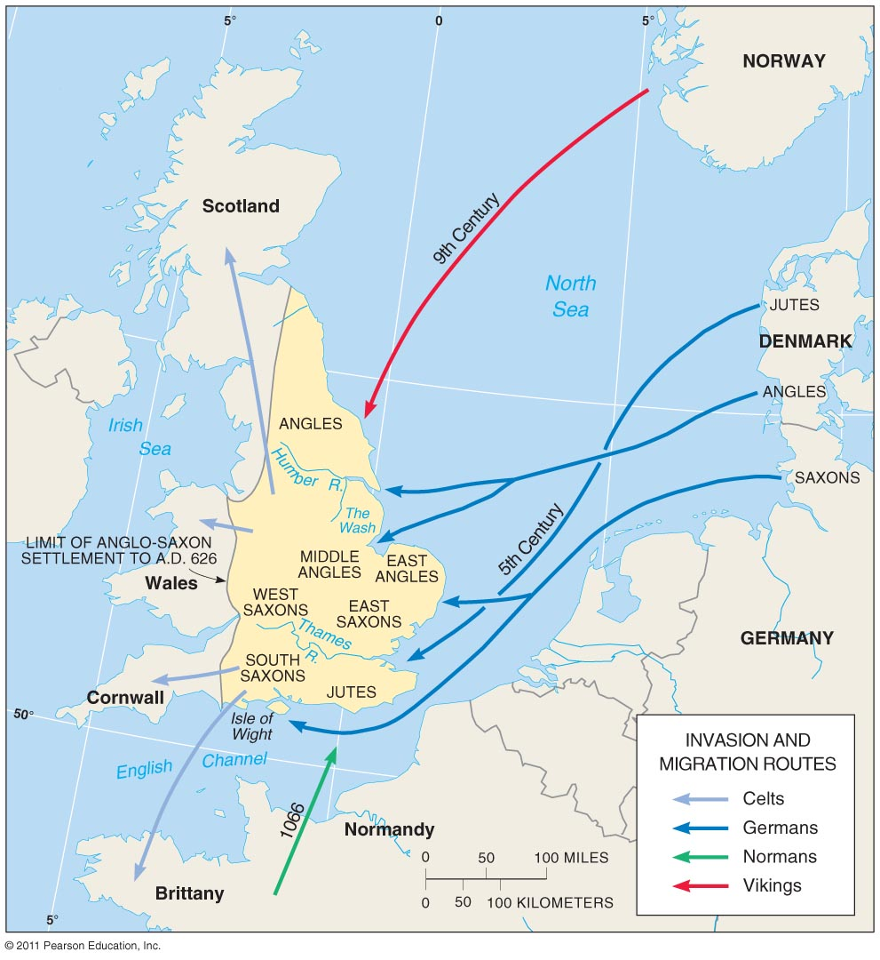
Invasions of England
Figure 5-3

Slide 6
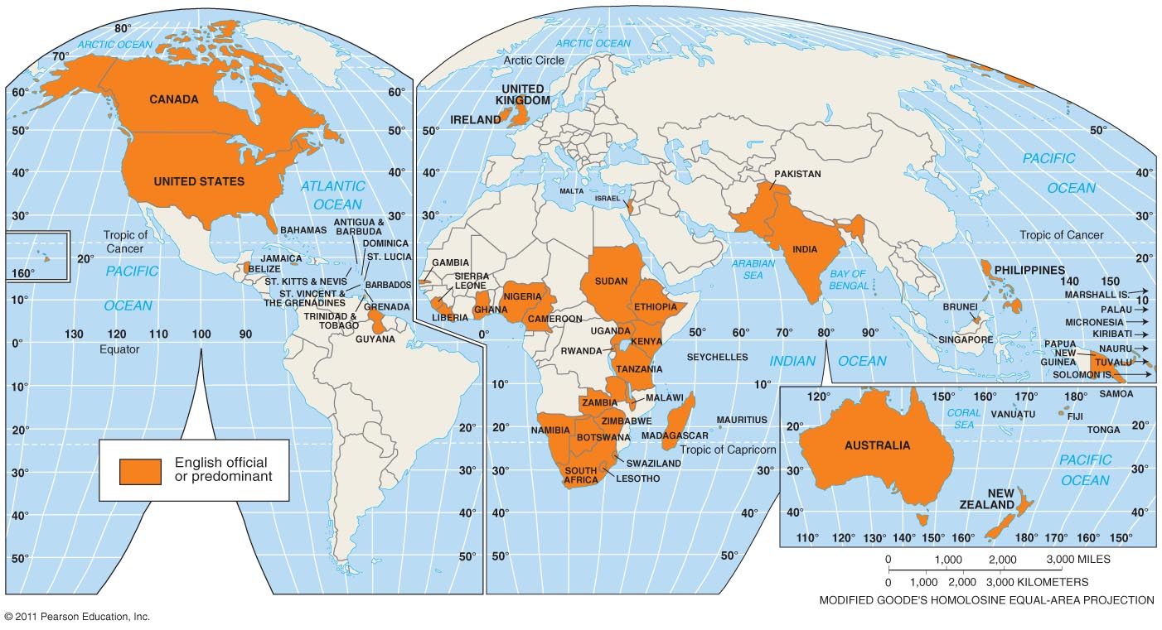
English-Speaking Countries
Figure 5-2

Slide 7
Colonial Possessions, 1914

Slide 8
Where Are English Language Speakers Distributed?
Dialects of English
Dialect = a regional variation of a language
Isogloss = a word-usage boundary
Standard language = a well-established dialect
Dialects
In England
Differences between British and American English

Slide 9
Where Are English Language Speakers Distributed?
Dialects of English
Dialects in the United States
Settlement in the eastern United States
Current differences in the eastern United States
Pronunciation differences
http://www.businessinsider.com/22-maps-that-show-the-deepest-linguistic-conflicts-in-america-2013-6?op=1

Slide 10
Why Is English Related to Other Languages?
Indo-European branches
Language branch = collected of related languages
Indo-European = eight branches
Four branches have a large number of speakers:
Germanic
Indo-Iranian
Balto-Slavic
Romance

Slide 11
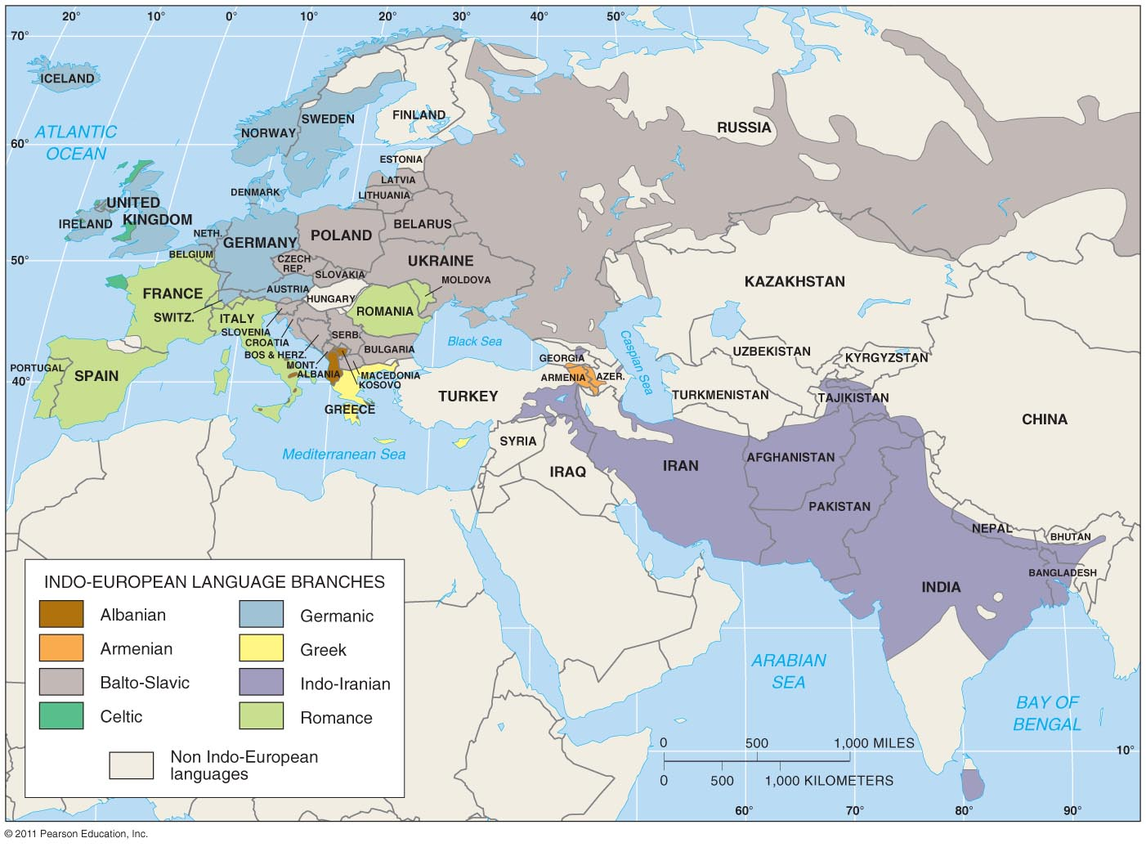
Branches of the Indo-European Family
Figure 5-9

Slide 12
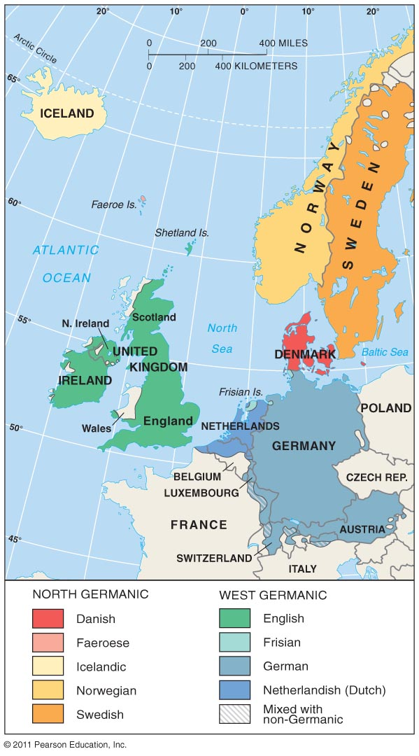
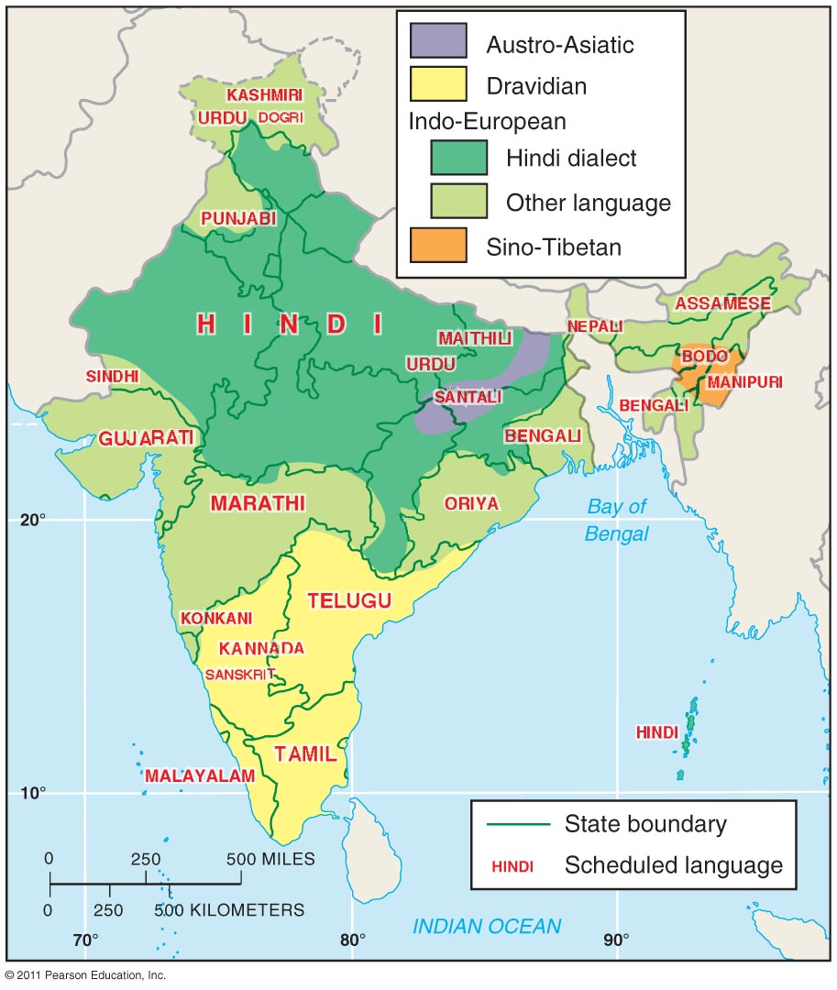
Linguistic Differences in Europe and India
Figure 5-10
Figure 5-11

Slide 13
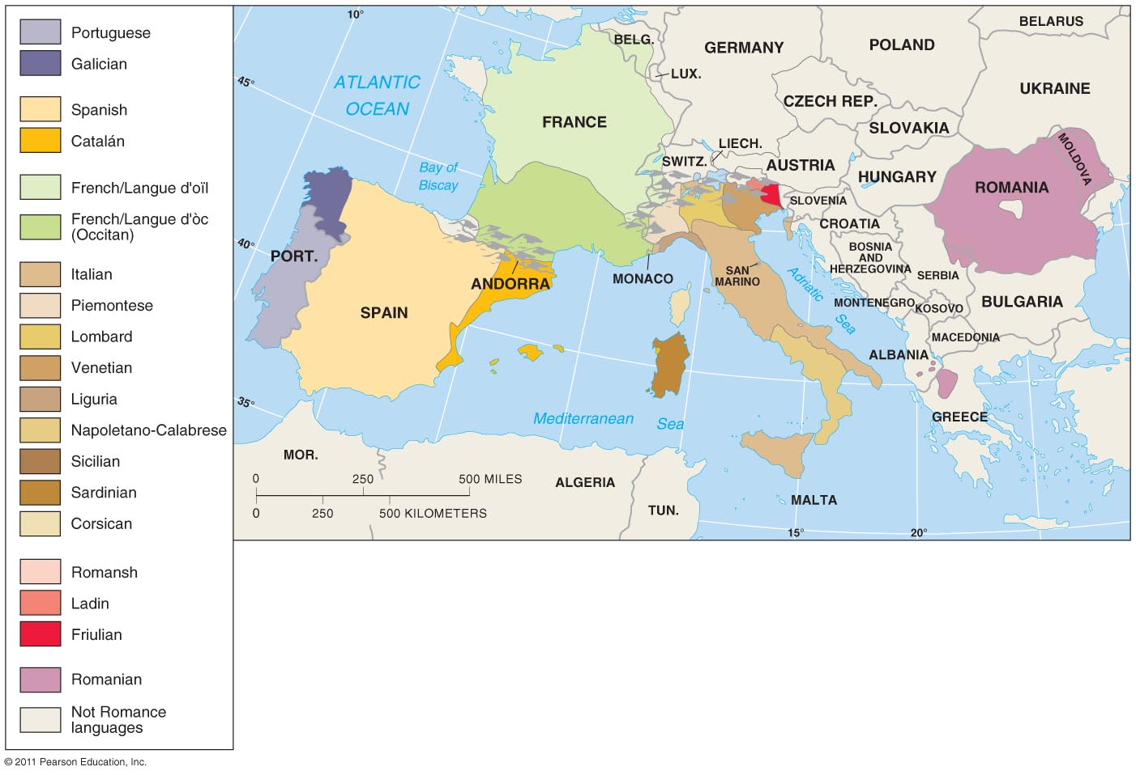
Romance Branch
Figure 5-12

Slide 14
Why Is English Related to Other Languages?
Origin and diffusion of Indo-European
A “Proto-Indo-European” language?
Internal evidence
Nomadic warrior theory
Sedentary farmer theory

Slide 15
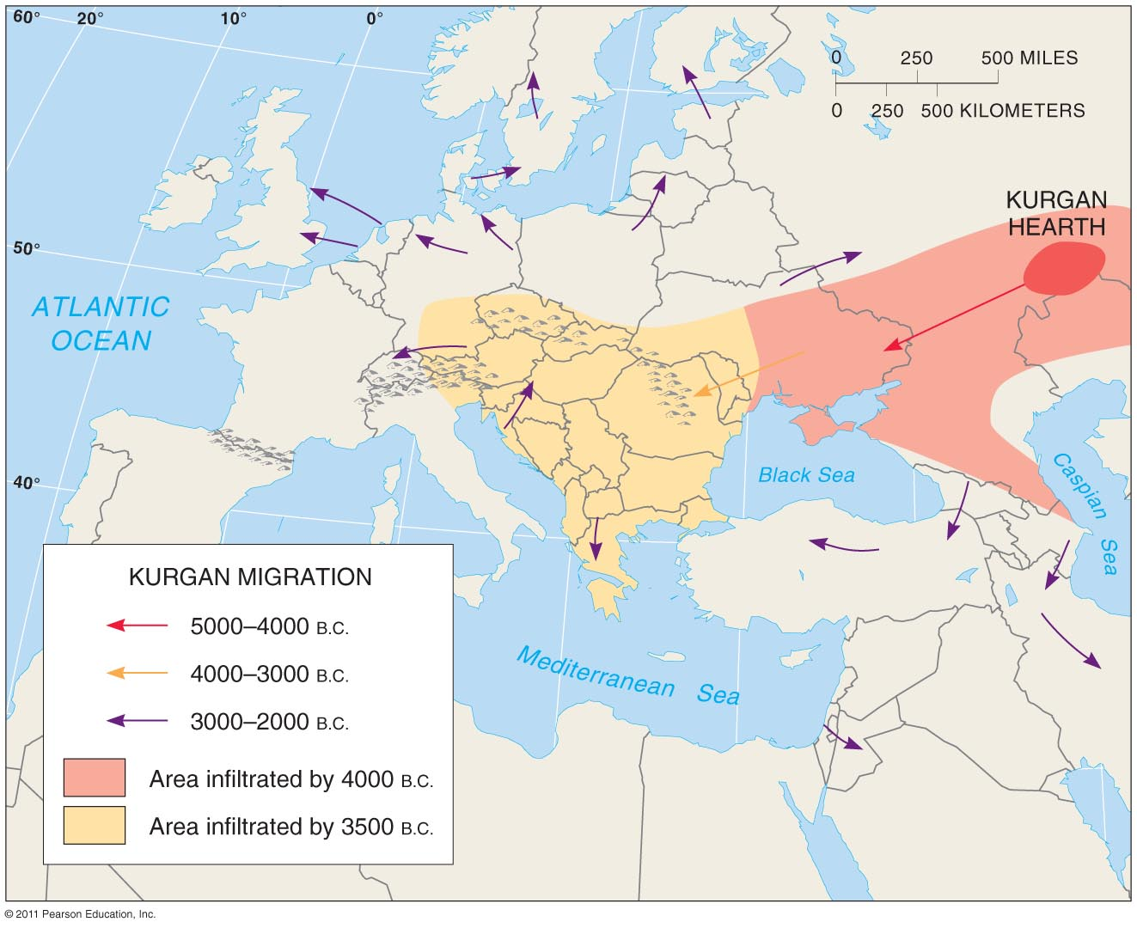
Nomadic Warrior Theory
Figure 5-14

Slide 16
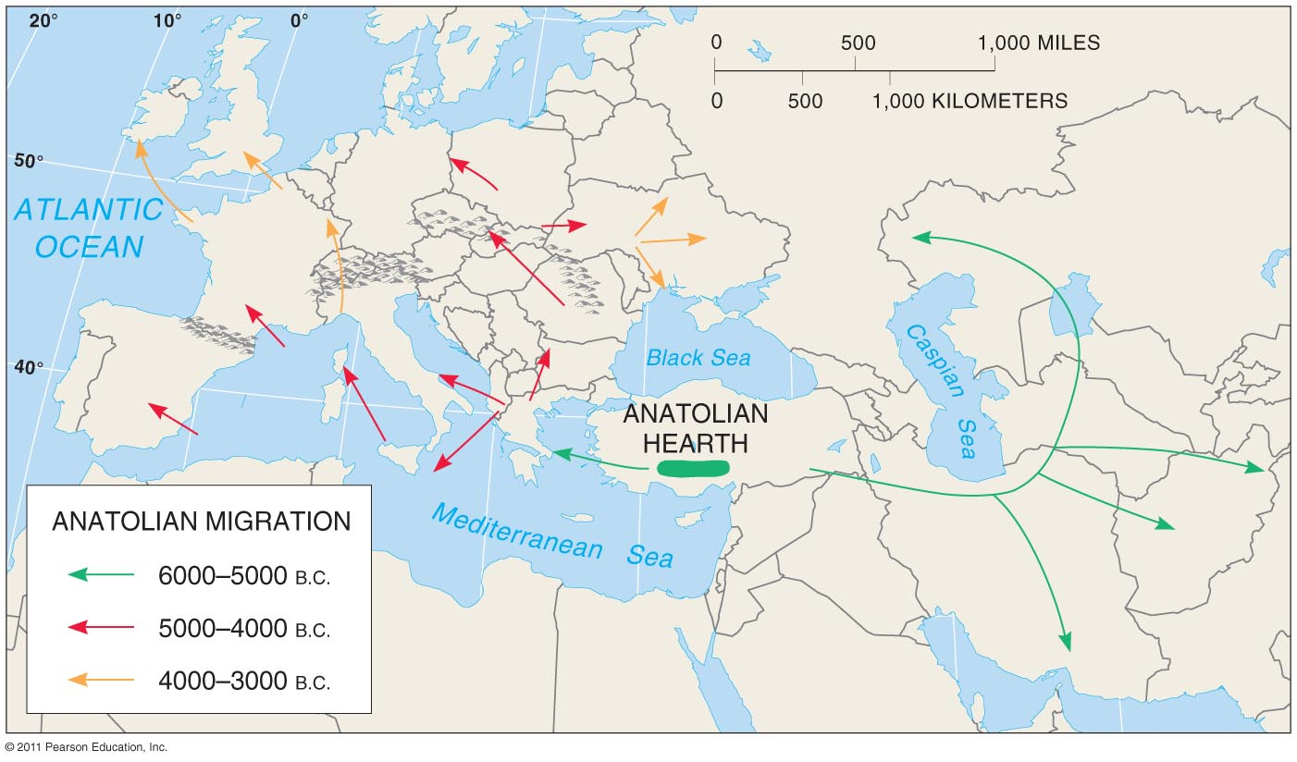
Sedentary Farmer Theory
Figure 5-15

